Slide 1
Introduction to BeagleBone Programming with C/C++

Slide 2
General Concerns About Embedded Program Development
Resources are more restricted
You should be concerned about memory, disk and network usage.
Hardware is important
The interaction with outside world will be through hardware. You programs will rely on hardware more.
You should optimize your code after it is completed.

Slide 3
CPU FREQUENCY
#cpufreq-info
cpufrequtils 008: cpufreq-info (C) Dominik Brodowski 2004-2009
Report errors and bugs to cpufreq@vger.kernel.org, please.
analyzing CPU 0:
driver: generic_cpu0
CPUs which run at the same hardware frequency: 0
CPUs which need to have their frequency coordinated by software: 0
maximum transition latency: 300 us.
hardware limits: 300 MHz - 1000 MHz
available frequency steps: 300 MHz, 600 MHz, 800 MHz, 1000 MHz
available cpufreq governors: conservative, ondemand, userspace, powersave, performance
current policy: frequency should be within 300 MHz and 1000 MHz.
The governor "ondemand" may decide which speed to use
within this range.
current CPU frequency is 300 MHz.
cpufreq stats: 300 MHz:99.07%, 600 MHz:0.04%, 800 MHz:0.02%, 1000 MHz:0.86% (12)

Slide 4
CPU FREQUENCY
cpufreq-set - A small tool which allows to modify cpufreq settings.
Example:
cpufreq-set -g performance
root@beaglebone:~# cpufreq-info
cpufrequtils 008: cpufreq-info (C) Dominik Brodowski 2004-2009
Report errors and bugs to cpufreq@vger.kernel.org, please.
analyzing CPU 0:
driver: generic_cpu0
CPUs which run at the same hardware frequency: 0
CPUs which need to have their frequency coordinated by software: 0
maximum transition latency: 300 us.
hardware limits: 300 MHz - 1000 MHz
available frequency steps: 300 MHz, 600 MHz, 800 MHz, 1000 MHz
available cpufreq governors: conservative, ondemand, userspace, powersave, per formance
current policy: frequency should be within 300 MHz and 1000 MHz.
The governor "performance" may decide which speed to use
within this range.
current CPU frequency is 1000 MHz (asserted by call to hardware).
cpufreq stats: 300 MHz:98.72%, 600 MHz:0.05%, 800 MHz:0.03%, 1000 MHz:1.20% ( 19)

Slide 5
Making a Choice
Scripting Languages
Bash Scripting
Perl
Python
Interpreted Languages
JavaScript and Node.js
Java
C/C++

Slide 6
Scripting
Advantages | Disadvantages
Perfect for automating Linux system administration tasks that require calls to Linux commands | Performance is poor for complex numerical or algorithmic tasks.
Easy to modify and adapt to changes. Source code is always present and complex toolchains are not required in order to make modifications. Generally, nano is the only tool that you need. | Generally, relatively poor/slow programming support for data structures, graphical user interfaces, sockets, threads, etc.
Generally, straightforward programming syntax and structure that is reasonably easy to learn when compared to languages like C++ and Java. | Generally, poor support for complex applications involving multiple, userdeveloped modules or components (Python and Perl do support OOP).
Generally, quick turnaround in coding solutions by occasional programmers. | Code is in the open. Direct access to view your code can be an intellectual property or a security concern. Lack of development tools

Slide 7
JAVA
Advantages | Disadvantages
Code is portable. Code compiled on the PC can be executed on the BBB or another embedded Linux platform. | You cannot currently build your Java applications directly on the BBB.
There is a vast and extensive library of code available that can be fully integrated in your project. | Executing as root is slightly diffi cult due to required environment variables.
Full OOP support | It’s not suitable for scripting.
Can be used for user‐interface application development on the BBB when it is attached to a display. | Computational performance is very respectable, but slower than optimized C/ C++ programs. Slightly heavier on memory
Strong support for multi‐threading. | Strictly typed and no unsigned integer types
Has automatic memory allocation and de‐allocation using a garbage collector, removing memory leak concerns. | Royalty payment required if deployed to a platform that “involves or controls hardware”
 | Sandboxed applications do not have access to system memory, registers or system calls (except through /proc) or JNI (Java Native Interface).

Slide 8
C/C++
Advantages | Disadvantages
You can build code directly on the BBB or you can cross‐compile code. The C/C++ languages are ISO standards, not owned by a single vendor. | Compiled code is not portable. Code compiled for your x86 desktop will not run on the BBB ARM processor.
C++ has full support for procedural programming, OOP, and support for generics through the use of STL (Standard Template Library). | Many consider the languages to be complex to master. There is a tendency to need to know everything before you can do anything.
It gives the best computational performance, especially if optimized; however, optimization can be diffi cult and can reduce the portability of your code. | The use of pointers and the low‐level control available makes code prone to memory leaks. With careful coding these can be avoided and can lead to effi ciencies over dynamic memory management schemes.
Can be used for user‐interface application development on the BBB using third‐party libraries. Libraries such as Qt and Boost provide extensive additional libraries for components, networking, etc. | By default, C and C++ do not support graphical user interfaces, network sockets, etc. Third‐party libraries are required.
Off ers low‐level access to glibc for integrating with the Linux system. Programs can be setuid to root. | Not suitable for scripting (there is a C shell, csh, that does have syntax like C). Not ideal for web development either.
The Linux kernel is written in C and having knowledge of C/C++ can help if you ever have to write device drivers or contribute to Linux kernel development. | C++ attempts to span from low‐level to high‐level programming tasks, but it can be diffi cult to write very scalable enterprise or web applications.

Slide 9
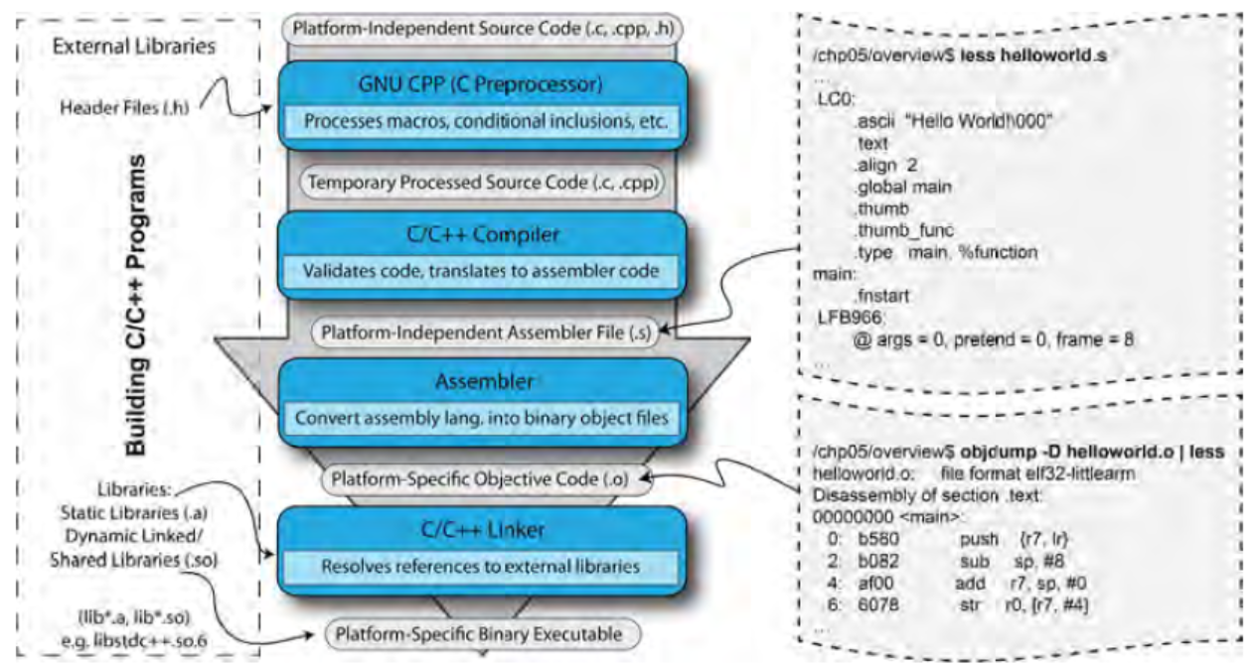
C/C++

Slide 10
Trying the Steps
$ gcc ‐E helloworld.c > processed.c
$ ls
helloworld.cpp processed.cpp
$ gcc ‐S processed.cpp ‐o helloworld.s
$ gcc ‐c helloworld.s
$ ls
helloworld.cpp helloworld.o helloworld.s processed.c
$ gcc helloworld.o ‐o helloworld
$ ls
helloworld helloworld.cpp helloworld.o helloworld.s processed.c
$ objdump –D helloworld | less
$ ./helloworld
Hello World!
$ objdump -S --disassemble helloworld > test.dump

Slide 11
Static Compilation
gcc ‐O3 test.c ‐static ‐o staticTest
the compiler and linker effectively place all the library routines required by your code directly within the program executable
program executable size grows significantly
the program can be executed by ARM systems on which the C++ standard libraries are not installed

Slide 12
Dynamic Libraries
Use ldd to check your dynamic libraries
$ ldd sample
libc.so.6 => /lib/arm-linux-gnueabihf/libc.so.6 (0xb6e7f000)
/lib/ld-linux-armhf.so.3 (0xb6f75000)

Slide 13
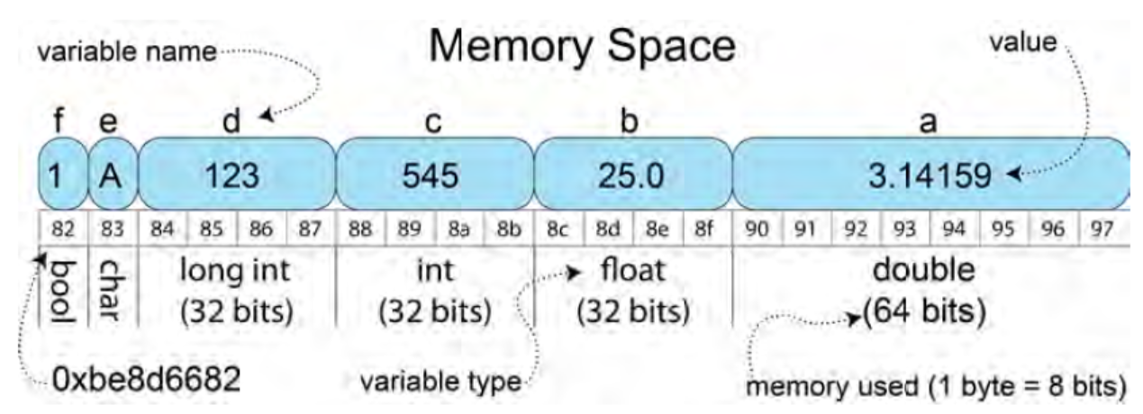
Variables
#include<stdio.h>
#include<stdbool.h>
int main(){
double a = 3.14159;
float b = 25.0;
int c = 545;
long int d = 123;
char e = 'A';
bool f = true; // no need for definition in C++
printf("a value %.4f and size %d bytes (@addr %p).\n", a, sizeof(a), &a);
printf("b value %4.2f and size %d bytes (@addr %p).\n", b, sizeof(b), &b);
printf("c value %d (oct %o, hex %x) and " \
"size %d bytes (@addr %p).\n", c, c, c, sizeof(c), &c);
printf("d value %d and size %d bytes (@addr %p).\n", d, sizeof(d), &d);
printf("e value %c and size %d bytes (@addr %p).\n", e, sizeof(e), &e);
printf("f value %5d and size %d bytes (@addr %p).\n", f, sizeof(f), &f);
}

Slide 14
GNU C Library glibc
http://www.gnu.org/software/libc/manual/
#include<unistd.h>
#include<stdio.h>
int main(){
printf("The user logged in is %s\n", getlogin());
return 0;
}

Slide 15
syscall
performs a general system call using the arguments that you pass to the function
http://syscalls.kernelgrok.com/

Slide 16
POSIX Threads
POSIX threads (Pthreads) is a set of C functions, types, and constants that provides everything you need in order to implement threading within your C/C++ applications on the BBB.
Adding threading to your code allows parts of your code to execute apparently concurrently (the BBB has a single core processor), with each thread receiving a “slice” of processing time.

Slide 17
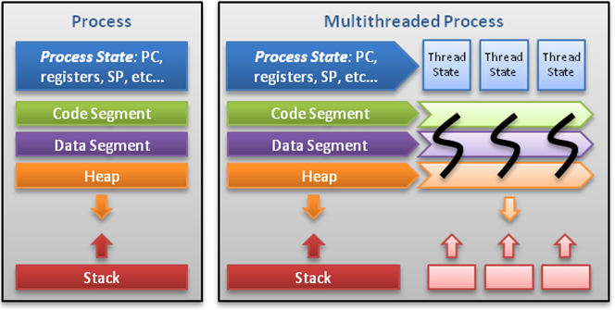
Threads

Slide 18
Pthread.H
Add #include <pthread.h> to your source file(s).
If you are using gcc, you can simply specify -pthread which will set all proper defines and link-time libraries.

Slide 19
A pthread is represented by the type pthread_t. To create a thread, the following function is available:
int pthread_create(pthread_t *thread, pthread_attr_t *attr, void *(*start_routine)(void *), void *arg);
pthread_t *thread: the actual thread object that contains pthread id
pthread_attr_t *attr: attributes to apply to this thread
void *(*start_routine)(void *): the function this thread executes
void *arg: arguments to pass to thread function above
void pthread_exit(void *value_ptr);
int pthread_join(pthread_t thread, void **value_ptr);
pthread_exit() terminates the thread and provides the pointer *value_ptr available to any pthread_join() call. pthread_join() suspends the calling thread to wait for successful termination of the thread specified as the first argument pthread_t thread with an optional *value_ptr data passed from the terminating thread's call to pthread_exit().

Slide 20
Example
#include <stdio.h>
#include <stdlib.h>
#include <pthread.h>
#define NUM_THREADS 2
/* create thread argument struct for thr_func() */
typedef struct _thread_data_t {
int tid;
double stuff;
} thread_data_t;
/* thread function */
void *thr_func(void *arg) {
thread_data_t *data = (thread_data_t *)arg;
printf("hello from thr_func, thread id: %d\n", data->tid);
pthread_exit(NULL);
}
int main(int argc, char **argv) {
pthread_t thr[NUM_THREADS];
int i, rc;
/* create a thread_data_t argument array */
thread_data_t thr_data[NUM_THREADS];
/* create threads */
for (i = 0; i < NUM_THREADS; ++i) {
thr_data[i].tid = i;
if ((rc = pthread_create(&thr[i], NULL, thr_func, &thr_data[i]))) {
fprintf(stderr, "error: pthread_create, rc: %d\n", rc);
return EXIT_FAILURE;
}
}
/* block until all threads complete */
for (i = 0; i < NUM_THREADS; ++i) {
pthread_join(thr[i], NULL);
}
return EXIT_SUCCESS;
}

